Slide 1
DR.SNSRCAS, CBE
SUBJECT: ADVANCED JAVA PROGRAMMING
COURSE CODE:16UCA502
TITLE: Components of Collection
Framework
YEAR: V SEMESTER 2022-2023 (ODD)

Slide 2
Components of Collection Framework
The Collection in Java is a framework that provides an architecture to store and manipulate the group of objects.
Java Collections can achieve all the operations that you perform on a data such as searching, sorting, insertion, manipulation, and deletion.

Slide 3
Components of Collection Framework
Java Collection means a single unit of objects. Java Collection framework provides many interfaces (Set, List, Queue, Deque) and classes (ArrayList, Vector, LinkedList, PriorityQueue, HashSet, LinkedHashSet, TreeSet).

Slide 4
Components of Collection Framework
Java Collection means a single unit of objects. Java Collection framework provides many interfaces (Set, List, Queue, Deque) and classes (ArrayList, Vector, LinkedList, PriorityQueue, HashSet, LinkedHashSet, TreeSet).

Slide 5
Components of Collection Framework
What is Collection in Java
A Collection represents a single unit of objects, i.e., a group.
What is a framework in Java
It provides readymade architecture.
It represents a set of classes and interfaces.
It is optional.

Slide 6
Components of Collection Framework
What is Collection framework
The Collection framework represents a unified architecture for storing and manipulating a group of objects.
1. It has: Interfaces and its implementations, i.e., classes
2. Algorithm

Slide 7
Components of Collection Framework
Hierarchy of Collection Framework Let us see the hierarchy of Collection framework. The java.util package contains all the classes and interfaces for the Collection framework.

Slide 8
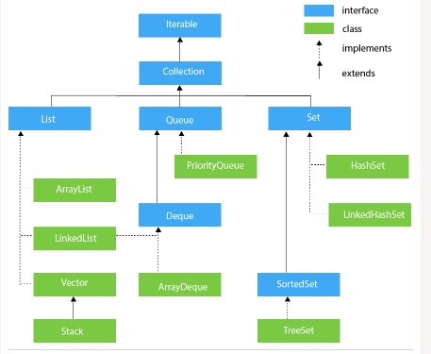
Components of Collection Framework

Slide 9
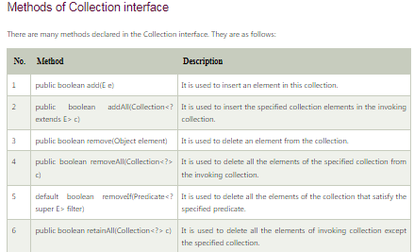
Components of Collection Framework

Slide 10
THANK YOU

